Slide 1
Slope project
Sara Hagenbucher

Slide 2
Introduction
In this presentation there will be images and information to help you better understand slope and the different types. Slope is a constant rate of change. Positive slope is when a line is going uphill from left to right, a negative slope is when a line is going downhill from left to right, a zero slope is when a line is horizontal, an undefined slope is when the line is vertical.

Slide 3
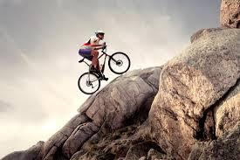
Positive Slope
In this example the positive
slope would be the biker riding
up the mountain.

Slide 4
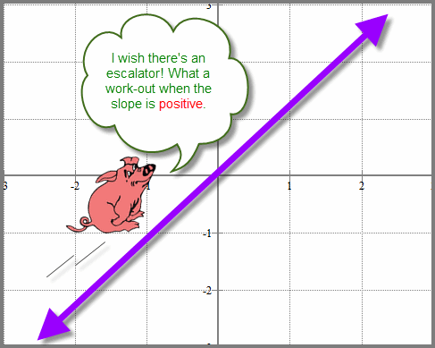
Positive slope

Slide 5
Negative Slope
In this example the negative
slope would be the boy in the
toy car going down the mountain.

Slide 6
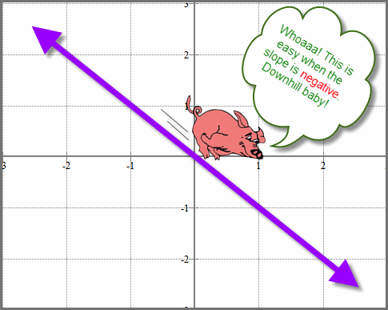
negative slope

Slide 7
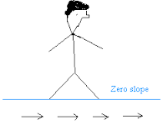
Zero Slope
In this example the zero slope
would be the ball sitting on
the flat surface.

Slide 8
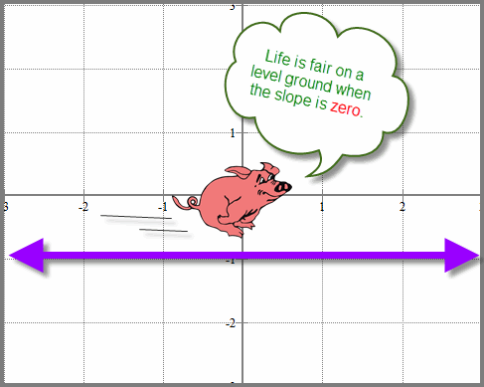
Zero slope

Slide 9
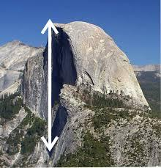
Undefined slope
the undefined slope would be the flat
side of the mountain.

Slide 10
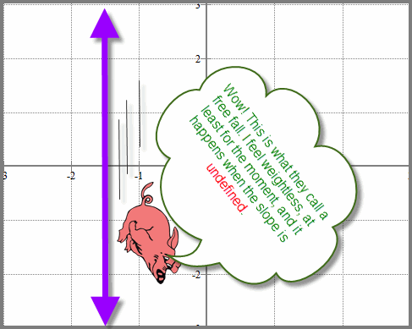
Undefined slope

Slide 11
